Slide 1
JAVA
UNIT 2(B)

Slide 2
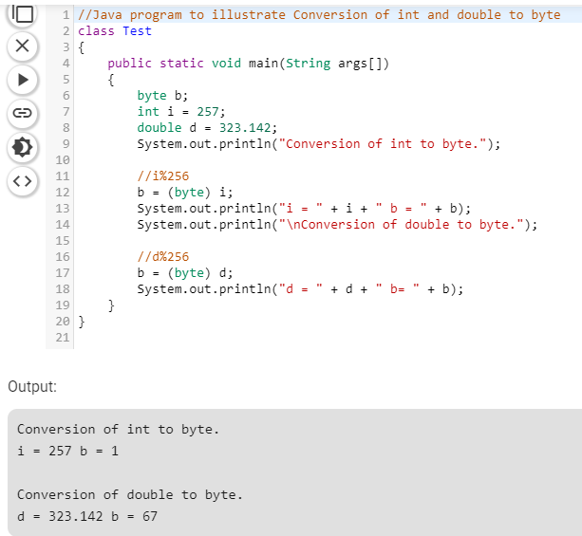

Slide 3
Type promotion
While evaluating expressions, the intermediate value may exceed the range of operands and hence the expression value will be promoted. Some conditions for type promotion are:
Java automatically promotes each byte, short, or char operand to int when evaluating an expression.
If one operand is a long, float or double the whole expression is promoted to long, float or double respectively.

Slide 4
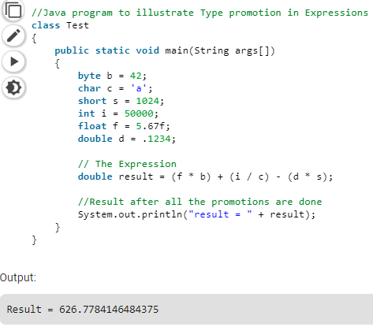
Example

Slide 5
Arrays
Java array is an object which contains elements of a similar data type.
Additionally, The elements of an array are stored in a contiguous memory location.
It is a data structure where we store similar elements. We can store only a fixed set of elements in a Java array.
Array in Java is index-based, the first element of the array is stored at the 0th index, 2nd element is stored on 1st index and so on

Slide 6
Array Declaration
An array declaration has two components: the type and the name. type declares the element type of the array.
The element type determines the data type of each element that comprises the array. Like array of int type. Int arrayA[];
we can also create an array of other primitive data types like char, float, double etc. or user defined data type(objects of a class).

Slide 7
Array Initialization
int intArray[];
intArray = new int[20];
or
int[] intArray = new int[20];

Slide 8
Types of Array in java
There are two types of array.
Single Dimensional Array
Multidimensional Array

Slide 9
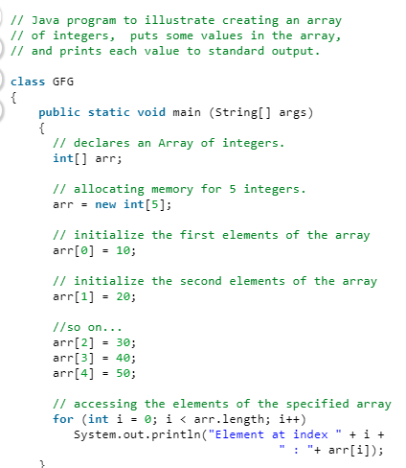
One dimensional array

Slide 10
Multidimensional Arrays
Multidimensional arrays are arrays of arrays with each element of the array holding the reference of other array. These are also known as Jagged Arrays.
A multidimensional array is created by appending one set of square brackets ([]) per dimension.
Examples:
Int intArray [][] = new int[10][20]; //a 2D array
int intArray [][][] = new int[10][20][10]; //a 3D array

Slide 11
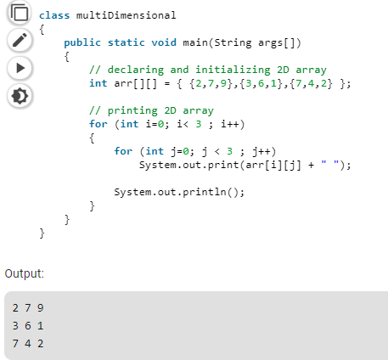
Multidimensional Arrays

Slide 12
Operators
https://www.geeksforgeeks.org/operators-in-java/
1000: 8 /4
>>2
0010: 2

Slide 13
Operator Precedence
https://introcs.cs.princeton.edu/java/11precedence/

Slide 14
Selection and Jump statements
https://www.geeksforgeeks.org/decision-making-javaif-else-switch-break-continue-jump/

Slide 15
Iteration statements
https://www.geeksforgeeks.org/loops-in-java/

Slide 16
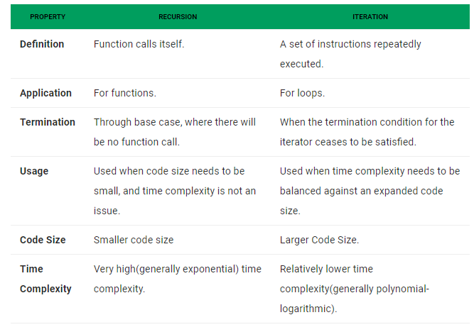
Recursion vs Iteration

Slide 17
